Slide 1

Tree and Ensemble Methods
Making decisions… better
Yordan Darakchiev
Technical Trainer
iordan93@gmail.com

Slide 2
sli.do #MachineLearning

Slide 3
Table of Contents
Decision trees
Ensemble algorithms
Random decision forests
AdaBoost

Slide 4
Decision Trees
"To be or not to be…"

Slide 5
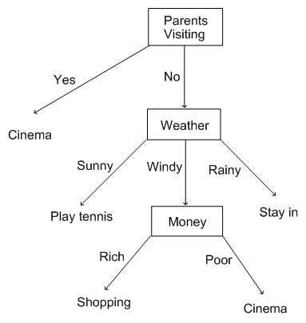
Decision Trees
Can be used for classification or regression
Root: top node (always a single root)
Leaves: bottom nodes
Getting an answer: path from root to a leaf
Biggest advantage: easy to interpret
Answer a series of yes / no questions to get the data model
Similar to the way we decide what to do
We can construct our own decision trees using if-statements
Machine learning problem: construct the tree without involving "brain power"

Slide 6
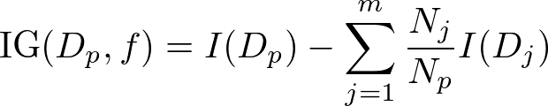


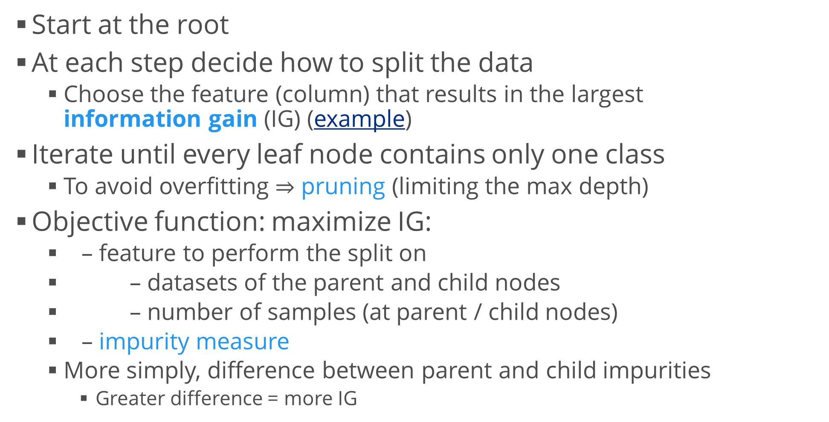
Decision Trees (2)
Start at the root
At each step decide how to split the data
Choose the feature (column) that results in the largest information gain (IG) (example)
Iterate until every leaf node contains only one class
To avoid overfitting $⇒$ pruning (limiting the max depth)
Objective function: maximize IG:
– feature to perform the split on
– datasets of the parent and child nodes
– number of samples (at parent / child nodes)
– impurity measure
More simply, difference between parent and child impurities
Greater difference = more IG

Slide 7
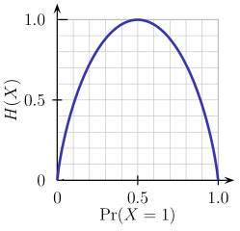
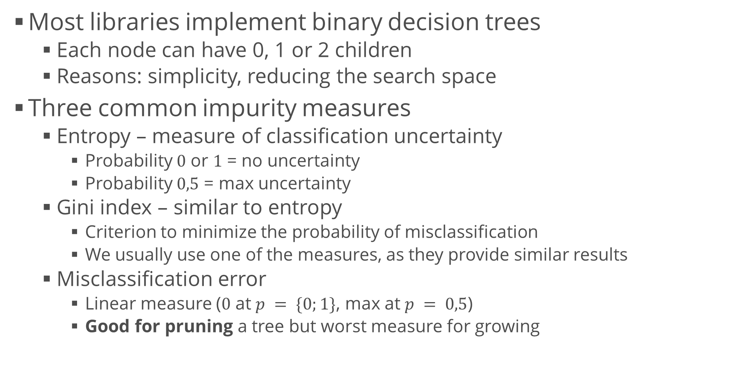
Impurity Measures
Most libraries implement binary decision trees
Each node can have 0, 1 or 2 children
Reasons: simplicity, reducing the search space
Three common impurity measures
Entropy – measure of classification uncertainty
Probability $0$ or $1$ = no uncertainty
Probability $0,5$ = max uncertainty
Gini index – similar to entropy
Criterion to minimize the probability of misclassification
We usually use one of the measures, as they provide similar results
Misclassification error
Linear measure ($0$ at $p = \{0;1\}$, max at $p = 0,5$)
Good for pruning a tree but worst measure for growing

Slide 8
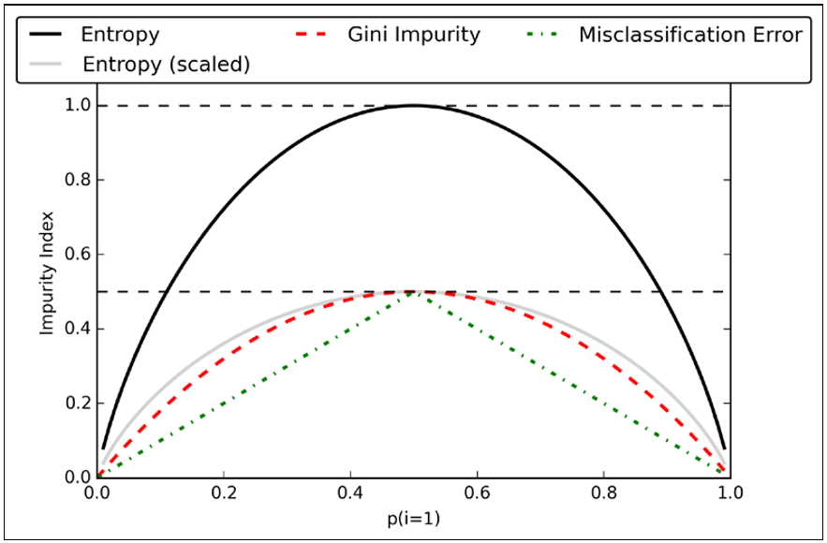

Visualizing Impurity Measures
For a two-class classifier, visualize the measures
Parameter p – probability of class 1 ($0≤p≤1$)
Scaled entropy: entropy / number of classes
Observations
Min: $p = \{0, 1\}$, max: $p = 0,5$
Entropy and Gini are very similar
def entropy(p):
return -p * np.log2(p) - (1 - p) * np.log2((1 - p))
def gini_index(p):
return p * (1 - p) + (1 - p) * (1 - (1 - p))
def misclassification_error(p):
return 1 - np.max([p, 1 - p])

Slide 9
Decision Trees in scikit-learn
Creating and fitting a classifier – as usual
Model hyperparameters
criterion: "gini" (default), "entropy"
max_depth
max_features (usually we don't change this)
Outputs
feature_importances_ – Gini scores for all features
n_classes_, n_features_
from sklearn.tree import DecisionTreeClassifier
decision_tree = DecisionTreeClassifier()
decision_tree.fit(attributes, labels)

Slide 10
Visualizing Decision Tree Boundaries
For simplicity, let's use the Iris dataset
This method can be applied to all classifiers, not only trees
Select 2 features (for a 2D plot)
Predict class values for a "mesh" of evenly-spaced samples
Plot the test data and predicted values in different colors (classes)
from sklearn.datasets import load_iris
iris = load_iris()
X = iris.data[:, :2] # Sepal length, sepal width
y = iris.target
h = 0.02 # Step size
color_dict = {0: "blue", 1: "lightgreen", 2: "red"}
colors = [color_dict[i] for i in y]
depth_2 = DecisionTreeClassifier(max_depth = 2).fit(X, y)
depth_4 = DecisionTreeClassifier(max_depth = 4).fit(X, y)
titles = ["Max depth = 2", "Max depth = 4"]

Slide 11
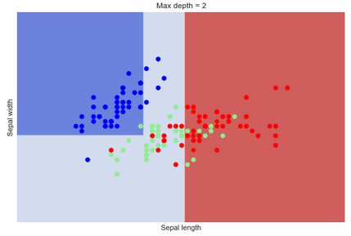
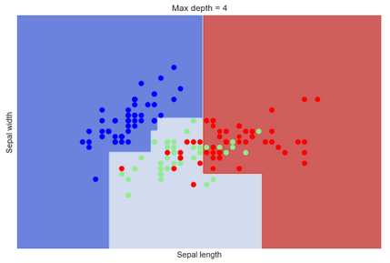
Visualizing Decision Tree Boundaries (2)
Create a mesh
Create and evaluate predictions for all classifiers
x_min, x_max = X[:, 0].min() - 1, X[:, 0].max() + 1
y_min, y_max = X[:, 1].min() - 1, X[:, 1].max() + 1
xx, yy = np.meshgrid(np.arange(x_min, x_max, h), np.arange(y_min, y_max, h))
for i, classifier in enumerate((depth_2, depth_4)):
plt.figure()
Z = classifier.predict(np.c_[xx.ravel(), yy.ravel()])
Z = Z.reshape(xx.shape)
plt.contourf(xx, yy, Z, cmap = plt.cm.coolwarm, alpha = 0.8)
plt.scatter(X[:, 0], X[:, 1], c = colors)
plt.xlabel("Sepal length")
plt.ylabel("Sepal width")
plt.xlim(xx.min(), xx.max())
plt.ylim(yy.min(), yy.max())
plt.xticks(())
plt.yticks(())
plt.title(titles[i])
plt.show()

Slide 12
Decision Forests
It's even harder to decide…

Slide 13
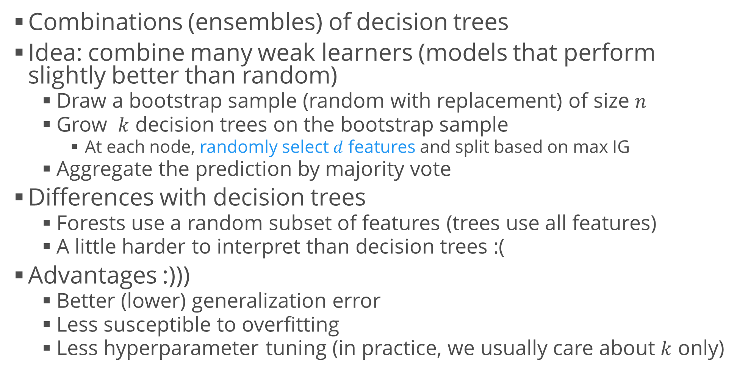
Random Forests
Combinations (ensembles) of decision trees
Idea: combine many weak learners (models that perform slightly better than random)
Draw a bootstrap sample (random with replacement) of size $n$
Grow $k$ decision trees on the bootstrap sample
At each node, randomly select $d$ features and split based on max IG
Aggregate the prediction by majority vote
Differences with decision trees
Forests use a random subset of features (trees use all features)
A little harder to interpret than decision trees :(
Advantages :)))
Better (lower) generalization error
Less susceptible to overfitting
Less hyperparameter tuning (in practice, we usually care about $k$ only)

Slide 14
AdaBoost
Short for "Adaptive Boosting"
Another method to combine weak learners into a strong one
Algorithm
Train a weak learner on a random subset (without replacement) of the test data
Draw another random subset and add 50% of the previously misclassified samples; train another weak learner on that
Find the training samples on which both learners disagree to train a third weak learner
Combine the three weak learners via majority voting
Those algorithms tend to overfit the data
We have to check variance carefully

Slide 15
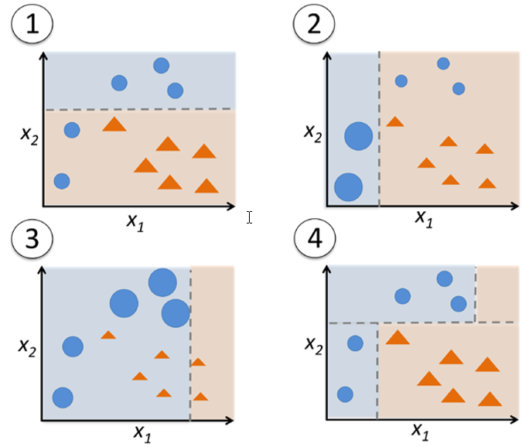
AdaBoost (2)
All samples have equal weight
First classifier: dashed line minimizes an error function
Assign larger weights to misclassified samples, lower weights to correctly classified samples
Second classifier: "focuses" on misclassified samples
The same as step 2 (we can perform many rounds of boosting)
Third classifier
End result: combination of all weak learners
Resulting classifier: combined results
Majority vote

Slide 16
Testing AdaBoost
Use an AdaBoost classifier to combine 100 "decision stumps" (i.e. decision trees with depth 1)
Use the adult income dataset
Compare the results to only one tree
from sklearn.metrics import accuracy_score
# Preprocessing, train / test split
# Single tree
tree = DecisionTreeClassifier(max_depth = 1)
tree.fit(features_train, labels_train)
train_pred = accuracy_score(labels_train, tree.predict(features_train))
test_pred = accuracy_score(labels_test, tree.predict(features_test))
print( "Decision tree train / test accuracies: %.3f / %.3f", (train_pred, test_pred))

Slide 17
Testing AdaBoost (2)
Results
AdaBoost is better in most cases
Predicts the test and train data better
AdaBoost has higher variance and reduced bias
Better comparison: cross validation; model selection process
CV + "hold-out" set
from sklearn.ensemble import AdaBoostClassifier # Boosted tree
tree = DecisionTreeClassifier(max_depth = 1)
ada = AdaBoostClassifier(base_estimator = tree, n_estimators = 100, learning_rate = 0.1)
ada.fit(features_train, labels_train)
train_pred = accuracy_score(labels_train, ada.predict(features_train))
test_pred = accuracy_score(labels_test, ada.predict(features_test))
print( "AdaBoost tree train / test accuracies: %.3f / %.3f",
(train_pred, test_pred))

Slide 18
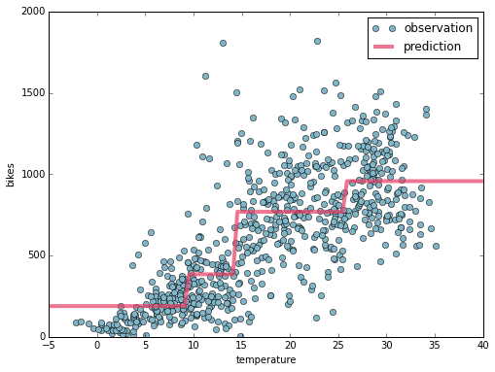
Other Algorithms
Regression with trees and forests
Not commonly used because of the model function
Stepwise, not smooth (i.e. no gradients), tends to overfit, etc.
Example
Gradient boosting
Boosting algorithm (similar to AdaBoost)
Trains on the remaining errors
Doesn't modify the sampling distribution
Example
XGBoost – eXtreme Gradient Boosting
Usually faster, performs better on large datasets

Slide 19
Summary
Decision trees
Ensemble algorithms
Random decision forests
AdaBoost

